Slide 1

Physical Layer Security over Fading Channels
Aristos KARAMPELAS TIMOTIEVITS
SUPERVISOR: THEODOROS TSIFTSIS

Slide 2
Wiretap Channel
Abraham Wyner (1975)
System model: Transmission of a message to a legitimate receiver over a noisy channel, in the presence of an eavesdropper.
Applications
Cryptography
Network Security
Not the ultimate reference for wireless communications!
Wireless Security is complex and multifaced
Information-theoretic considerations
Practical issues (authentication, protocols and physical layer security)

Slide 3
Secrecy as a performance metric
The ability to keep content of a communication private
Secrecy insurance methods
Encryption
Secure communication protocols
Sender/Receiver Authentication
Unauthorized access detection and prevention
Applications → Military communications, healthcare applications, IoT (Internet of Things)
Connection of secrecy and information theory → Secrecy capacity (Wyner, 1975)
Secure communication → Legitimate receiver’s channel quality is better than the eavesdropper’s.

Slide 4
Secrecy Outage Probability (SOP)
Secrecy capacity (SC): Maximum transmission rate at which security is guaranteed.
Well-defined quantity
Based on both transmitter and receiver information
Secrecy Outage Probability (SOP): Probability of mutual information between transmitter and receiver to be less than the mutual information between the transmitter and an eavesdropper.
Given certain level of transmit power and channel conditions
In poor channel conditions or insufficient transmit power, messages cannot be kept secret from the eavesdropper.
Determines the probability that the message is successfully intercepted by the eavesdropper
Secrecy and Security can be ensured by minimizing this quantity

Slide 5
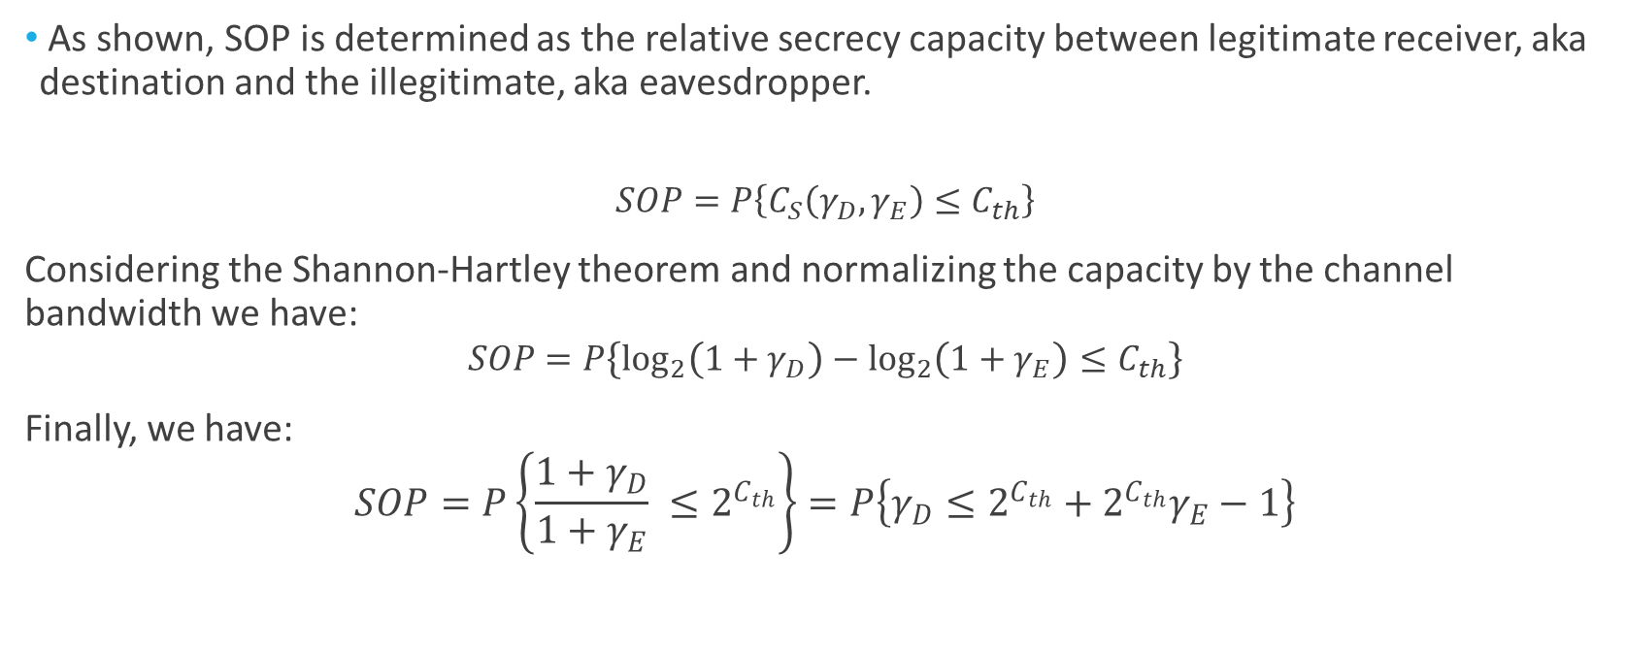
Mathematical expressions of SOP (1/2)
As shown, SOP is determined as the relative secrecy capacity between legitimate receiver, aka destination and the illegitimate, aka eavesdropper.
$$SOP=P\left\{C_{S}\left(γ_{D},γ_{E}\right)≤C_{th}\right\}$$
Considering the Shannon-Hartley theorem and normalizing the capacity by the channel bandwidth we have:
$$SOP=P\left\{\log_{2}\left(1+γ_{D}\right)−\log_{2}\left(1+γ_{Ε}\right)≤C_{th}\right\}$$
Finally, we have:
$$SOP=P\left\{\frac{1+γ_{D}}{1+γ_{E}} ≤2^{C_{th}}\right\}=P\left\{γ_{D}≤2^{C_{th}}+2^{C_{th}}γ_{Ε}−1\right\}$$

Slide 6

Mathematical expressions of SOP (2/2)
Probability calculation through CDF
$$F_{x}\left(x\right)=P\left(X≤x\right)=\int_{−∞}^{x}{f_{x}\left(t\right)dt}$$
SOP:
$$SOP≜\int_{0}^{∞}{\int_{0}^{λ+λγ_{Ε}−1}{f_{D}\left(γ_{D}\right)dγ_{D}}f_{E}\left(γ_{Ε}\right)dγ_{Ε}}$$
where $λ=2^{C_{th}}$, with $C_{th}$ the threshold capacity.
Finally, we have:
$$SOP≜\int_{0}^{∞}{F_{D}\left(λ+λγ_{Ε}−1\right)f_{E}\left(γ_{Ε}\right)dγ_{Ε}}$$

Slide 7
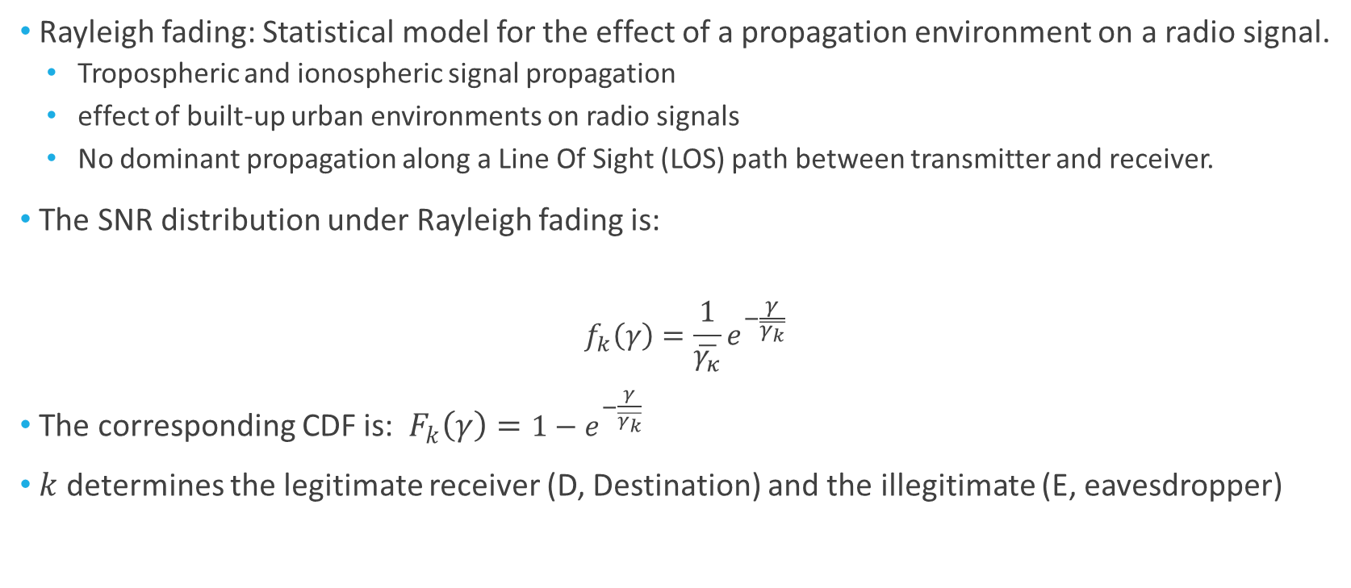
Rayleigh Fading Wiretap Channel
Rayleigh fading: Statistical model for the effect of a propagation environment on a radio signal.
Tropospheric and ionospheric signal propagation
effect of built-up urban environments on radio signals
No dominant propagation along a Line Of Sight (LOS) path between transmitter and receiver.
The SNR distribution under Rayleigh fading is:
$$f_{k}\left(γ\right)=\frac{1}{\overline{γ_{κ}}}e^{−\frac{γ}{\overline{γ_{k}}}}$$
The corresponding CDF is: $F_{k}\left(γ\right)=1−e^{−\frac{γ}{\overline{γ_{k}}}}$
$k$ determines the legitimate receiver (D, Destination) and the illegitimate (E, eavesdropper)

Slide 8
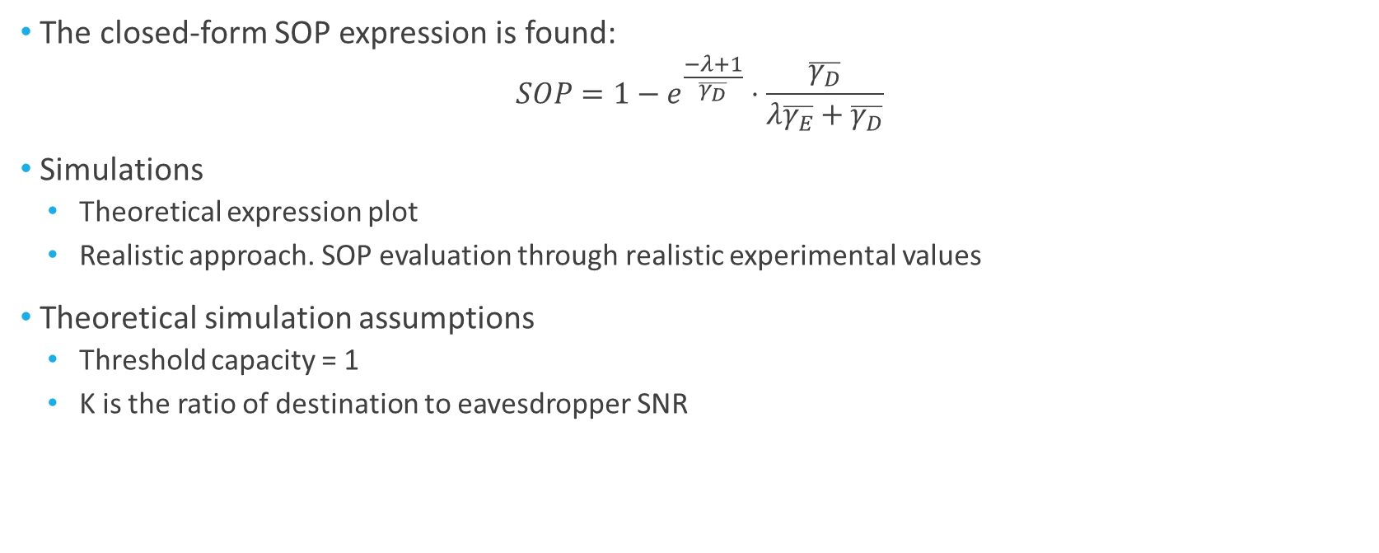
Rayleigh Fading SOP and Simulations (1/5)
The closed-form SOP expression is found:
$$SOP=1−e^{\frac{−λ+1}{\overline{γ_{D}}}}⋅\frac{\overline{γ_{D}}}{λ\overline{γ_{E}}+\overline{γ_{D}}}$$
Simulations
Theoretical expression plot
Realistic approach. SOP evaluation through realistic experimental values
Theoretical simulation assumptions
Threshold capacity = 1
K is the ratio of destination to eavesdropper SNR

Slide 9
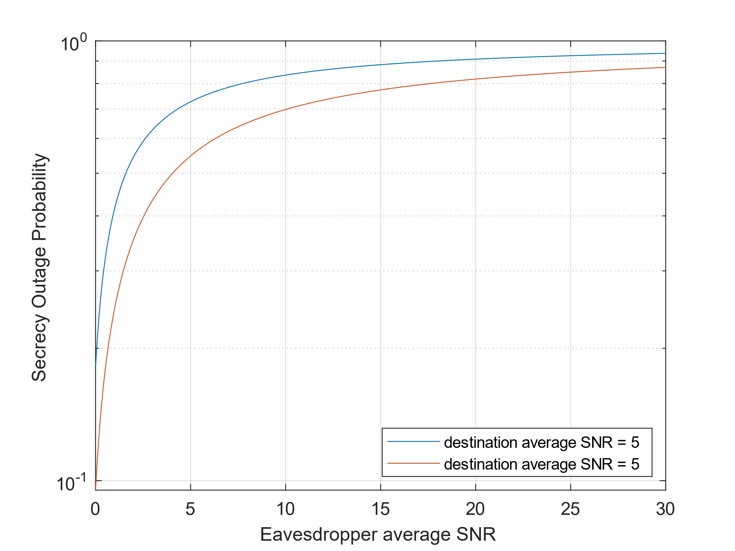
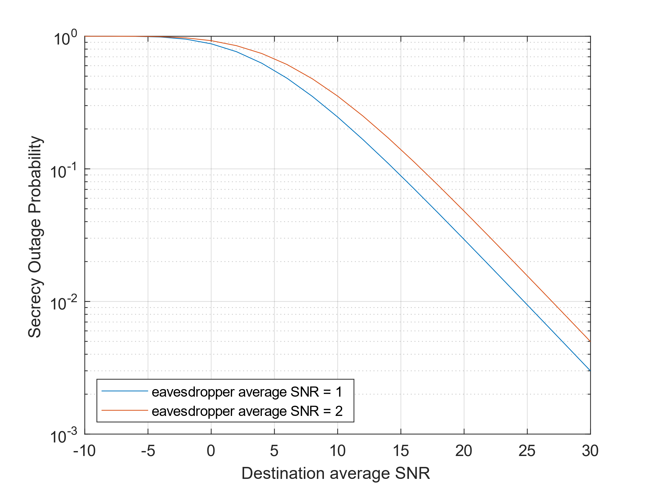
Rayleigh Fading SOP and Simulations (2/5)
Logarithmic scale plot of the SOP during varying eavesdropper SNR
Logarithmic scale plot of the SOP during varying destination SNR

Slide 10
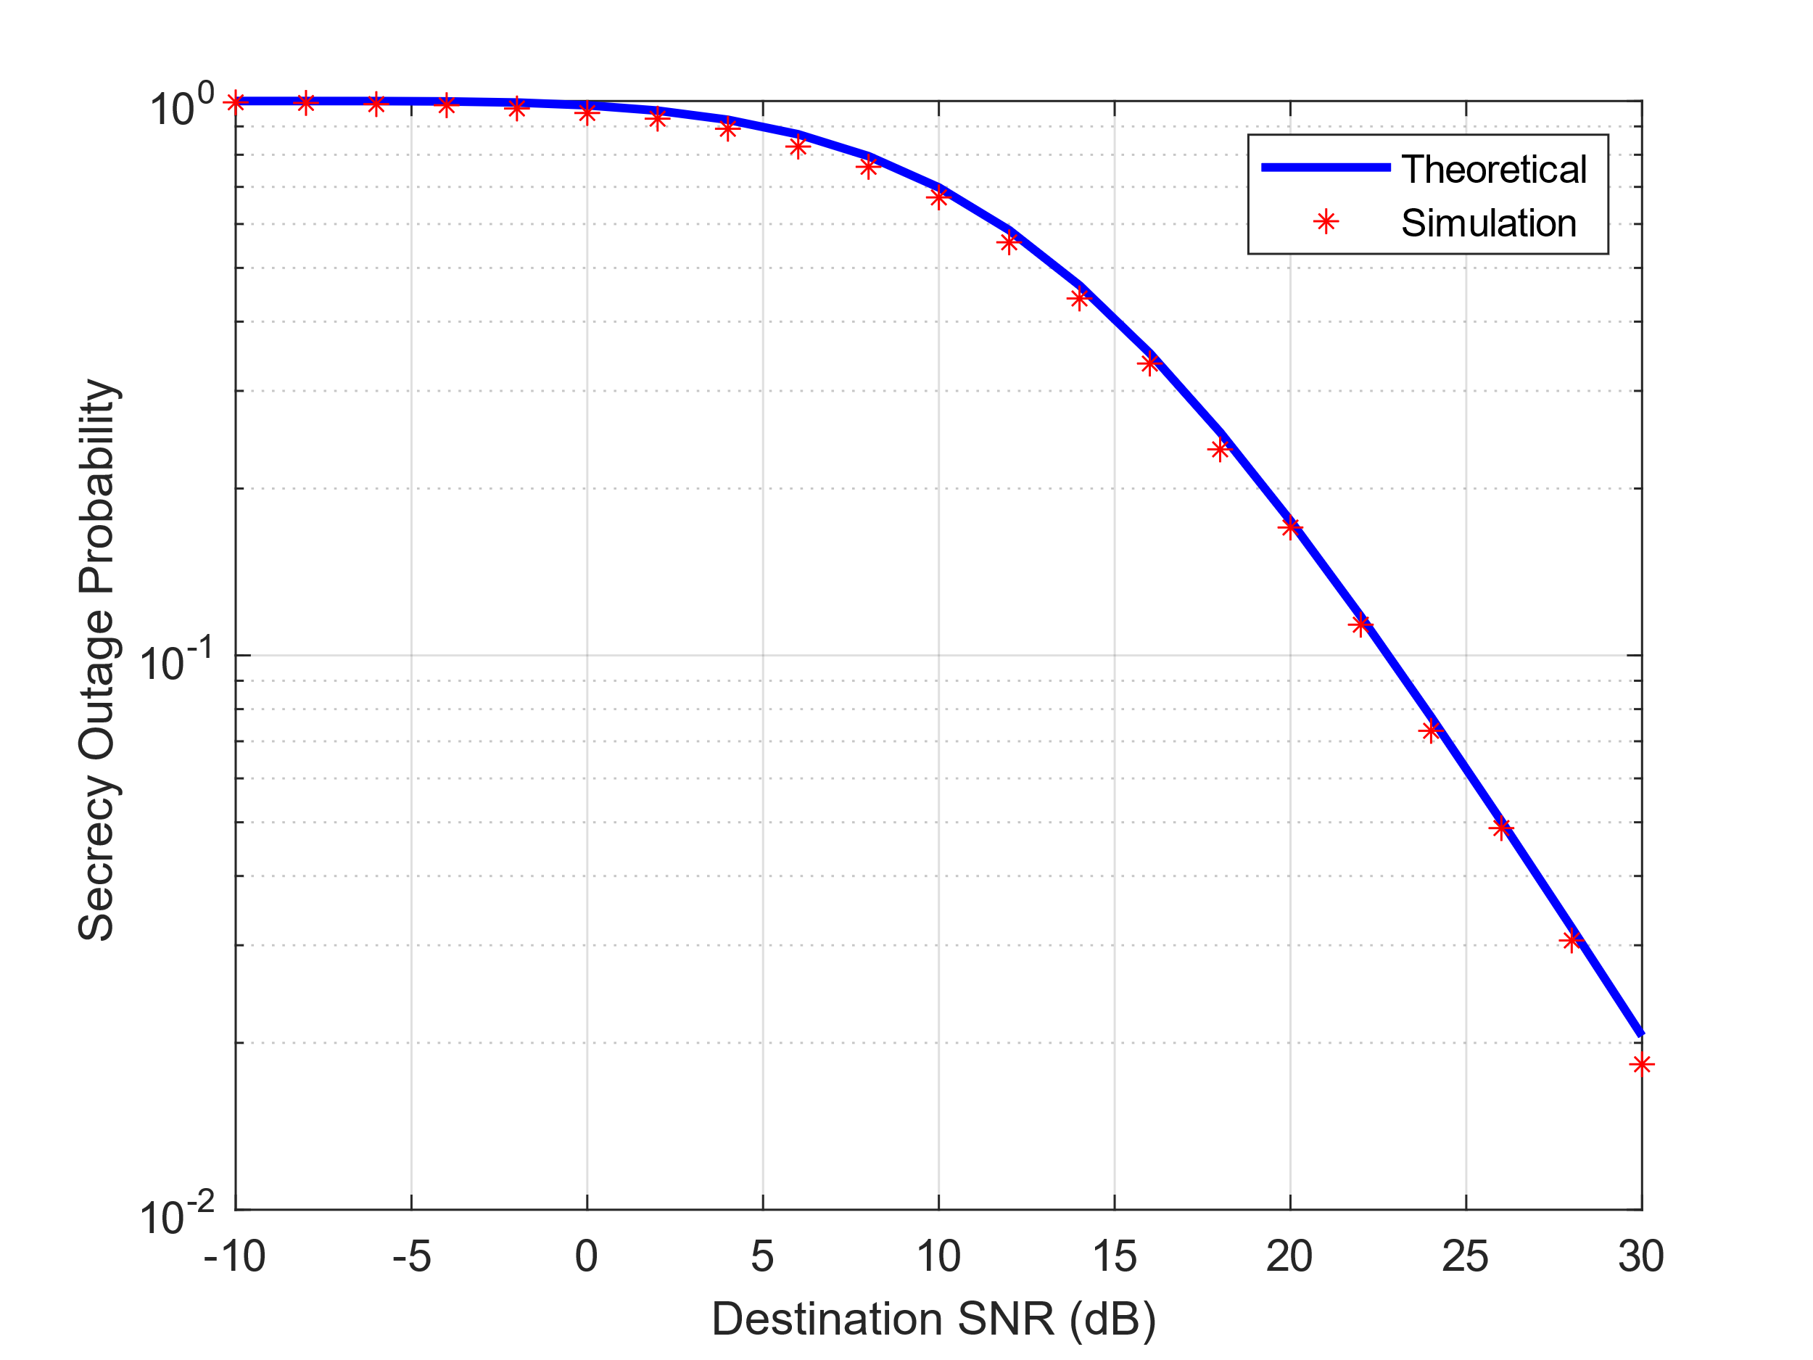
Rayleigh Fading SOP and Simulations (3/5)
Logarithmic scale plot of the SOP during varying destination SNR + simulation

Slide 11
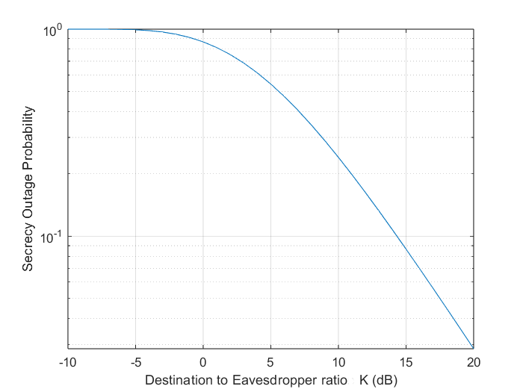
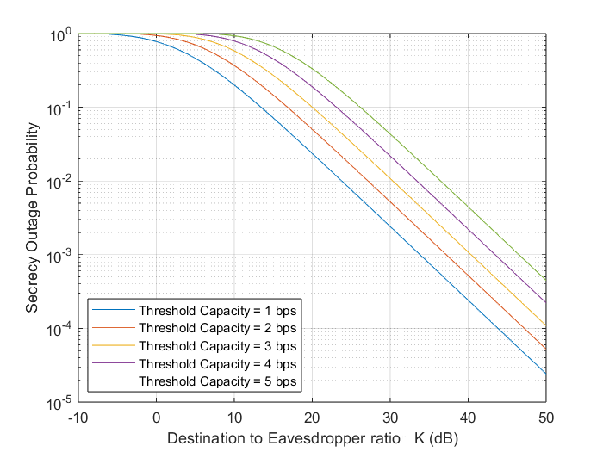
Rayleigh Fading SOP and Simulations (4/5)
Simulation plot of the analytical SOP expression FOR RATIO
Simulation plot of the analytical SOP expression in respect to varying K ratio and threshold capacity

Slide 12
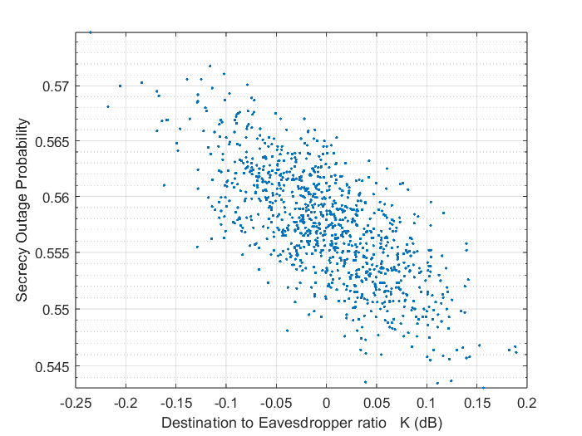
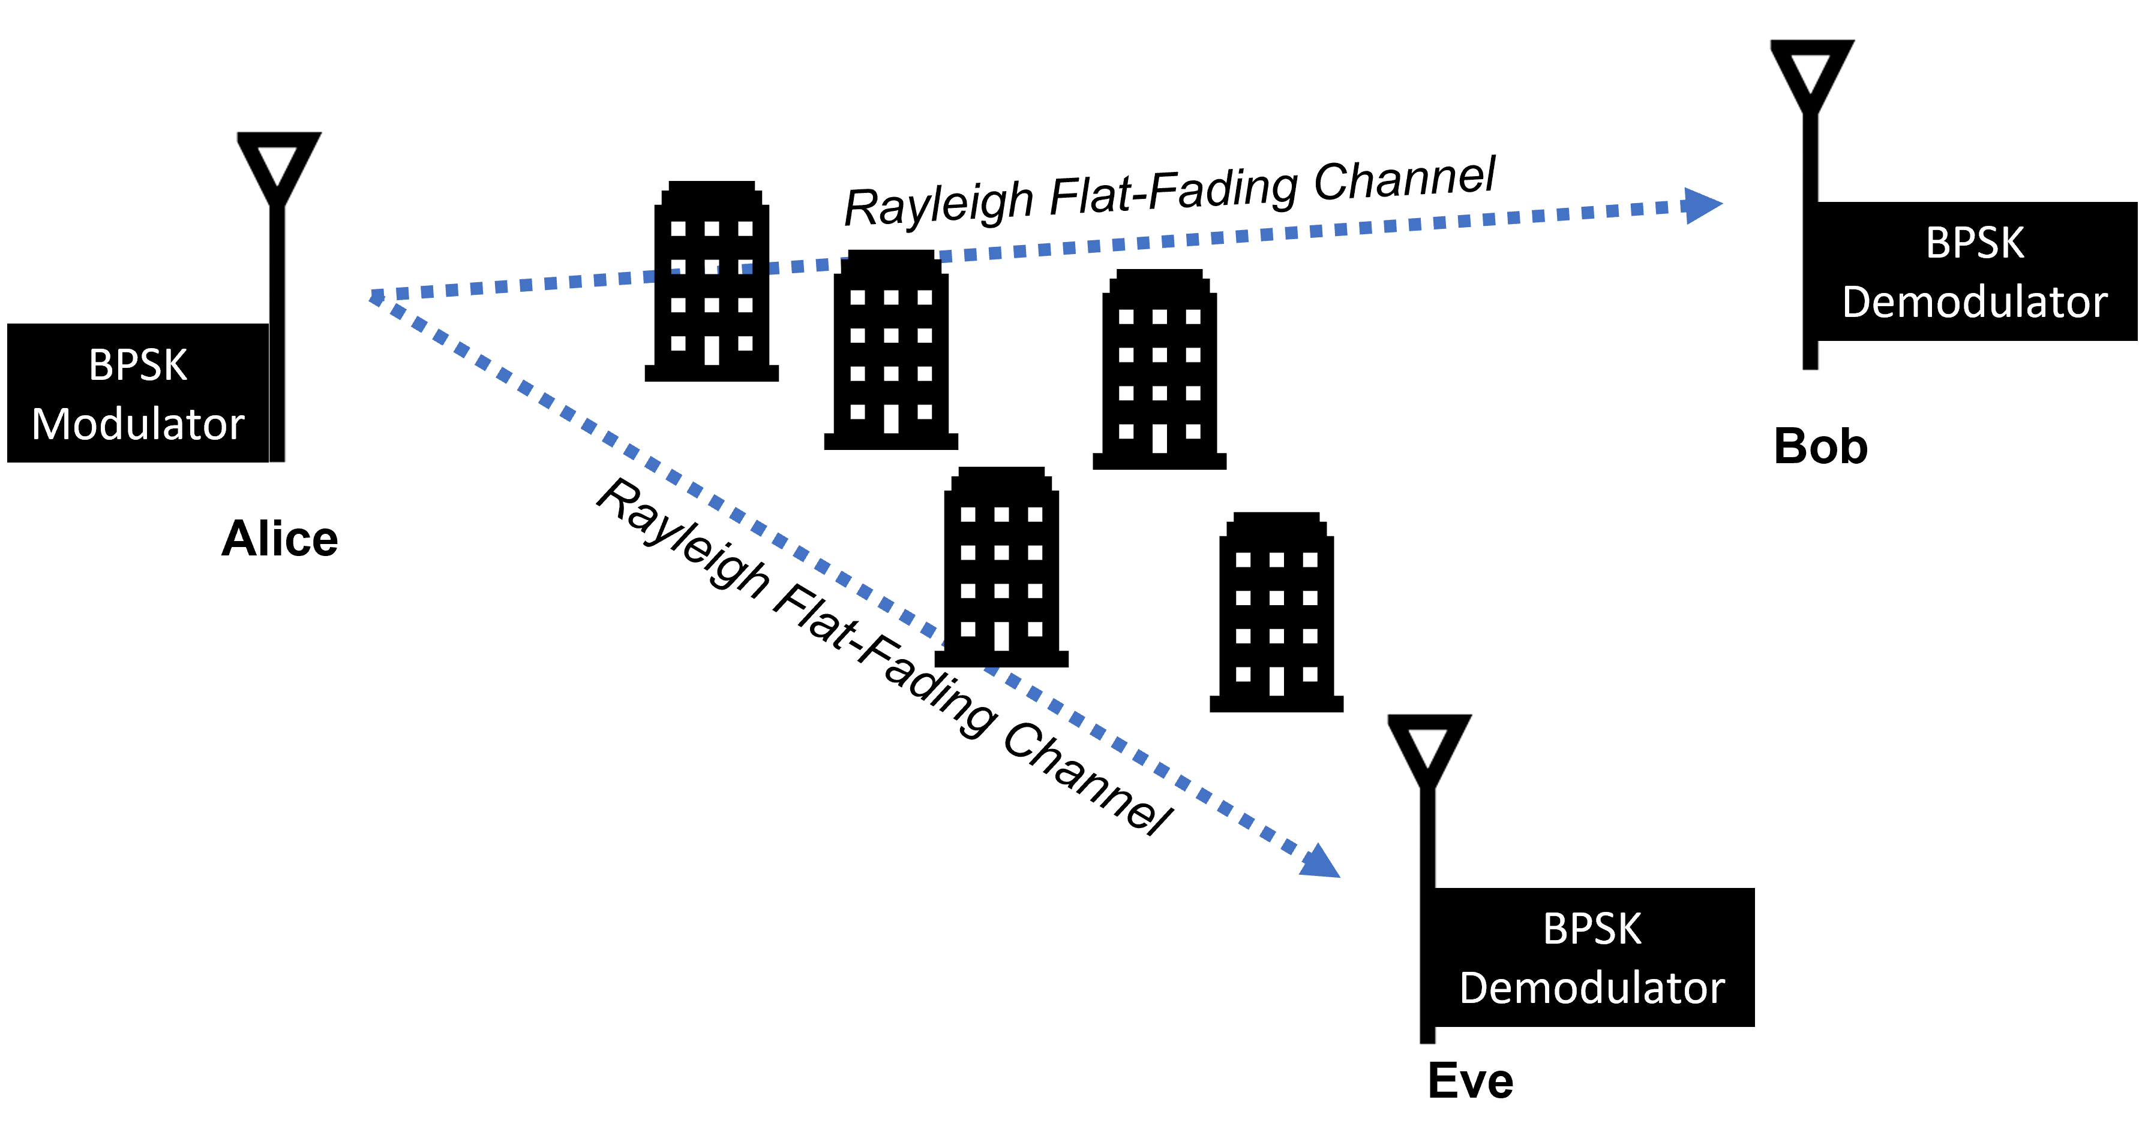
Rayleigh Fading SOP and Simulations (5/5)
System model
Demonstration of a realistic Rayleigh simulation (Monte-Carlo simulation)

Slide 13
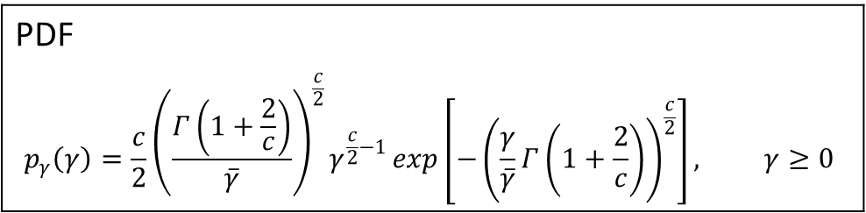
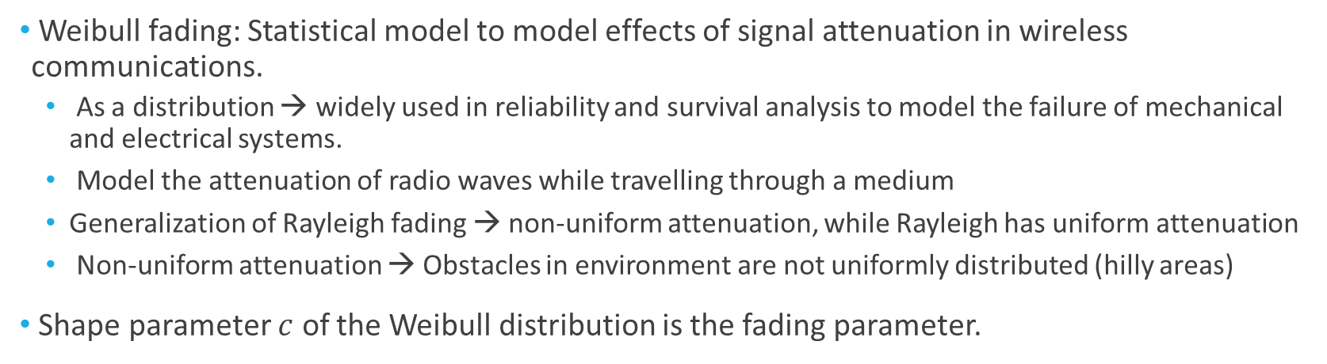
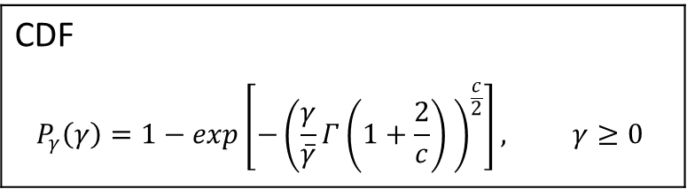
Weibull Fading Wiretap Channel
Weibull fading: Statistical model to model effects of signal attenuation in wireless communications.
As a distribution → widely used in reliability and survival analysis to model the failure of mechanical and electrical systems.
Model the attenuation of radio waves while travelling through a medium
Generalization of Rayleigh fading → non-uniform attenuation, while Rayleigh has uniform attenuation
Non-uniform attenuation → Obstacles in environment are not uniformly distributed (hilly areas)
Shape parameter $c$ of the Weibull distribution is the fading parameter.
PDF
$$p_{γ}\left(γ\right)=\frac{c}{2}{\left(\frac{Γ\left(1+\frac{2}{c}\right)}{\overline{γ}}\right)}^{\frac{c}{2}}γ^{\frac{c}{2}−1}\exp\left[−{\left(\frac{γ}{\overline{γ}}Γ\left(1+\frac{2}{c}\right)\right)}^{\frac{c}{2}}\right], γ≥0$$
CDF
$$P_{γ}\left(γ\right)=1−\exp\left[−{\left(\frac{γ}{\overline{γ}}Γ\left(1+\frac{2}{c}\right) \right)}^{\frac{c}{2}}\right], γ≥0$$

Slide 14
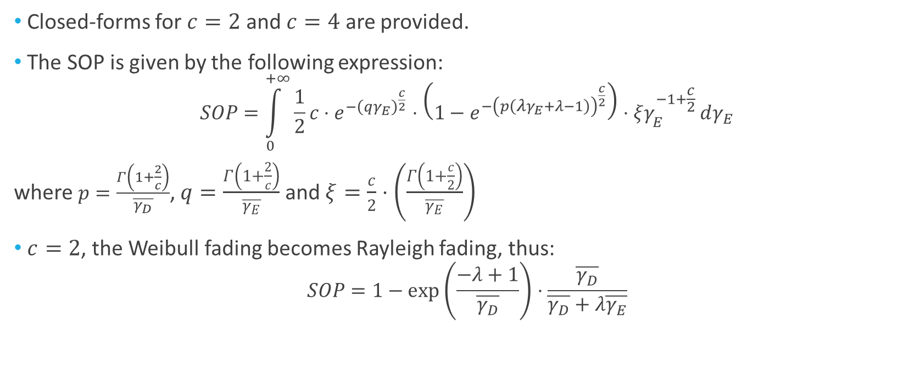
Rayleigh Fading SOP and Simulations (1/4)
Closed-forms for $c=2$ and $c=4$ are provided.
The SOP is given by the following expression:
$$SOP=\int_{0}^{+∞}{\frac{1}{2}c⋅e^{−{\left(qγ_{Ε}\right)}^{\frac{c}{2}}}⋅\left(1−e^{−{\left(p\left(λγ_{Ε}+λ−1\right)\right)}^{\frac{c}{2}}}\right)⋅ξγ_{Ε}^{−1+\frac{c}{2}}}dγ_{Ε}$$
where $p=\frac{Γ\left(1+\frac{2}{c}\right)}{\overline{γ_{D}}}$, $q=\frac{Γ\left(1+\frac{2}{c}\right)}{\overline{γ_{Ε}}}$ and $ξ=\frac{c}{2}⋅\left(\frac{Γ\left(1+\frac{c}{2}\right)}{\overline{γ_{Ε}}}\right)$
$c=2$, the Weibull fading becomes Rayleigh fading, thus:
$$SOP=1−\exp\left(\frac{−λ+1}{\overline{γ_{D}}}\right)⋅\frac{\overline{γ_{D}}}{\overline{γ_{D}}+λ\overline{γ_{E}}}$$

Slide 15
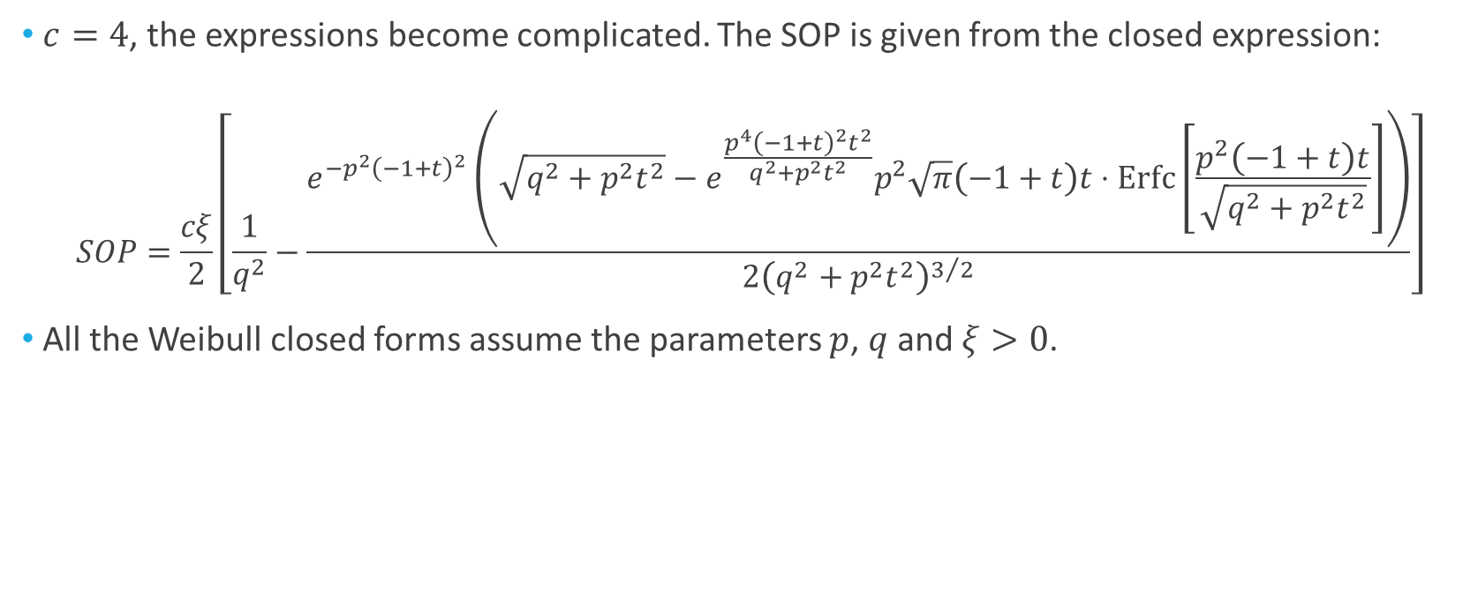
Rayleigh Fading SOP and Simulations (2/4)
$c=4$, the expressions become complicated. The SOP is given from the closed expression:
$$SOP=\frac{cξ}{2}\left[\frac{1}{q^{2}}−\frac{ⅇ^{−p^{2}{\left(−1+t\right)}^{2}}\left(\sqrt{q^{2}+p^{2}t^{2}}−ⅇ^{\frac{p^{4}{\left(−1+t\right)}^{2}t^{2}}{q^{2}+p^{2}t^{2}}}p^{2}\sqrt{π}\left(−1+t\right)t⋅Erfc\left[\frac{p^{2}\left(−1+t\right)t}{\sqrt{q^{2}+p^{2}t^{2}}}\right]\right)}{2{\left(q^{2}+p^{2}t^{2}\right)}^{3/2}}\right]$$
All the Weibull closed forms assume the parameters $p$, $q$ and $ξ>0$.

Slide 16
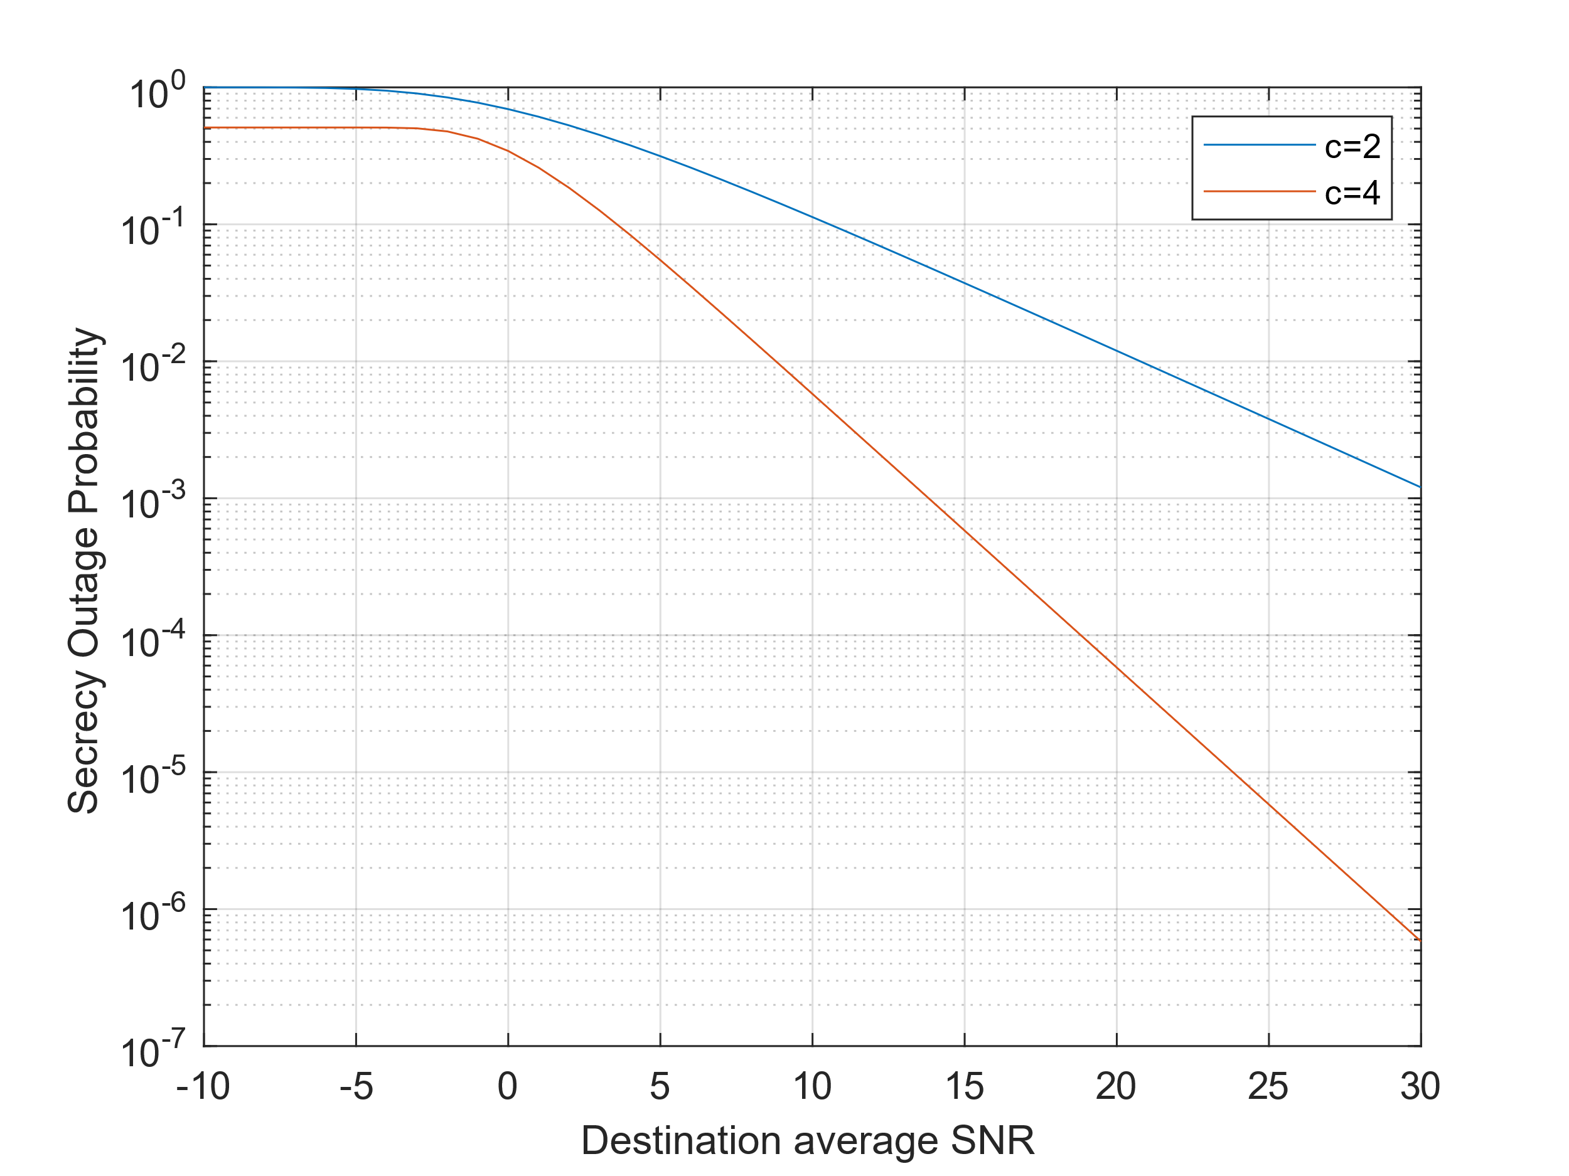
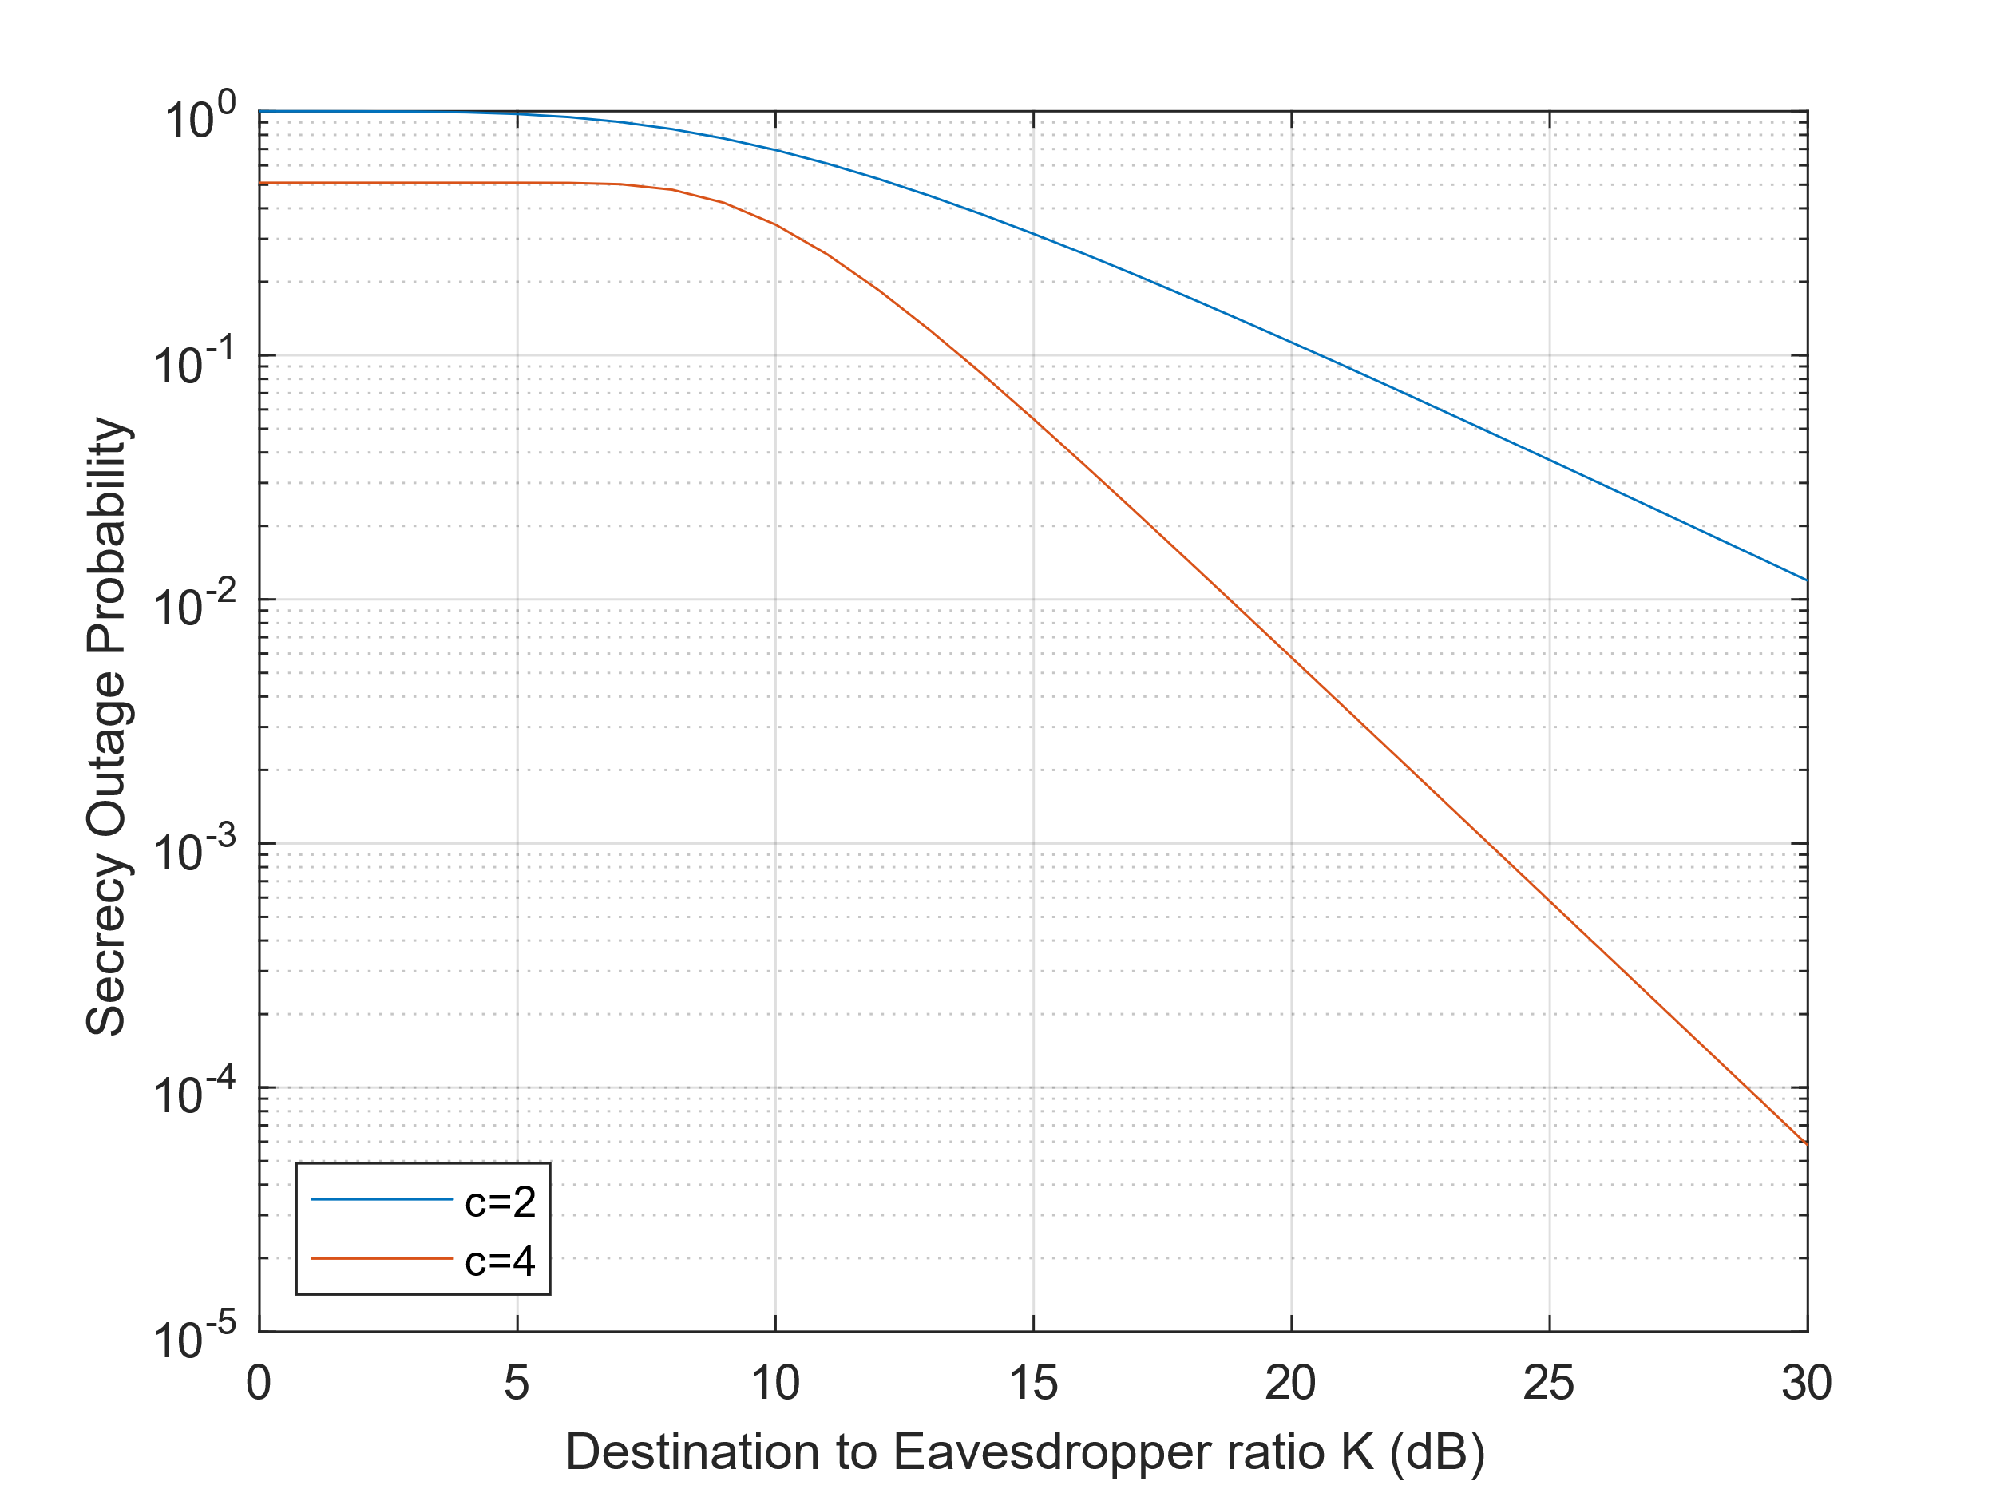
Rayleigh Fading SOP and Simulations (3/4)
Simulation of Weibull fading channel in respect to the destination average SNR
Simulation plot of the destination to eavesdropper ratio for the Weibull fading channel

Slide 17
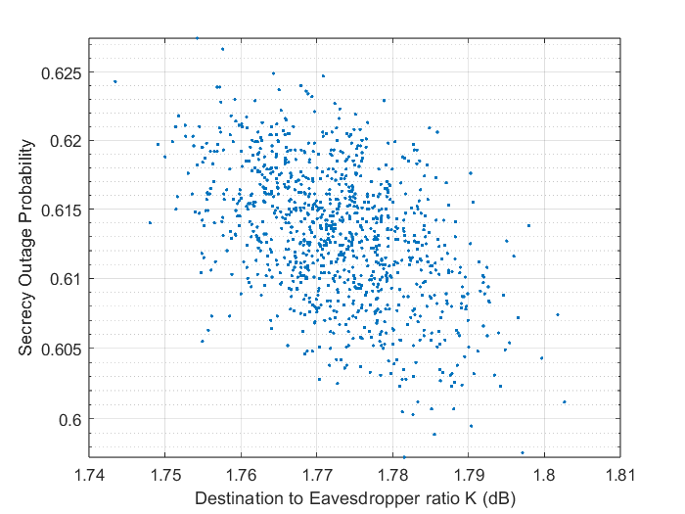
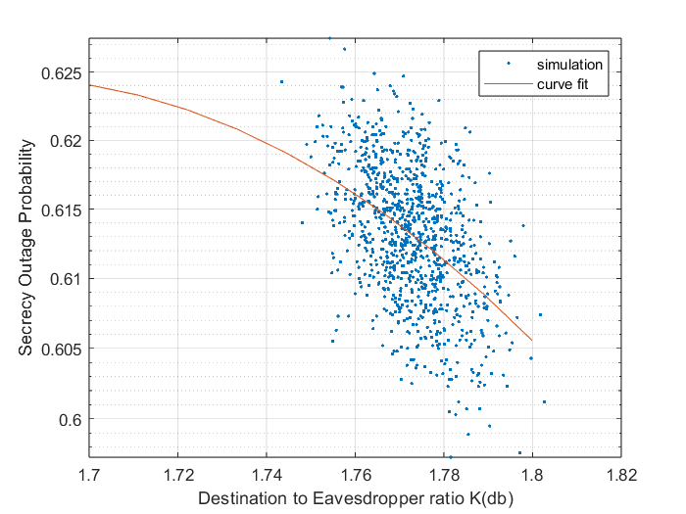
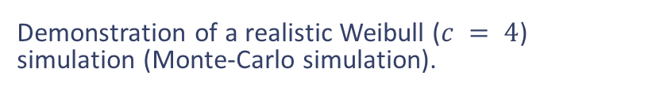
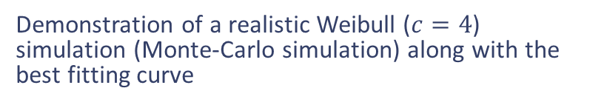
Rayleigh Fading SOP and Simulations (4/4)
Demonstration of a realistic Weibull ($c = 4$) simulation (Monte-Carlo simulation).
Demonstration of a realistic Weibull ($c=4$) simulation (Monte-Carlo simulation) along with the best fitting curve

Slide 18
Ευχαριστώ

